Slide 1
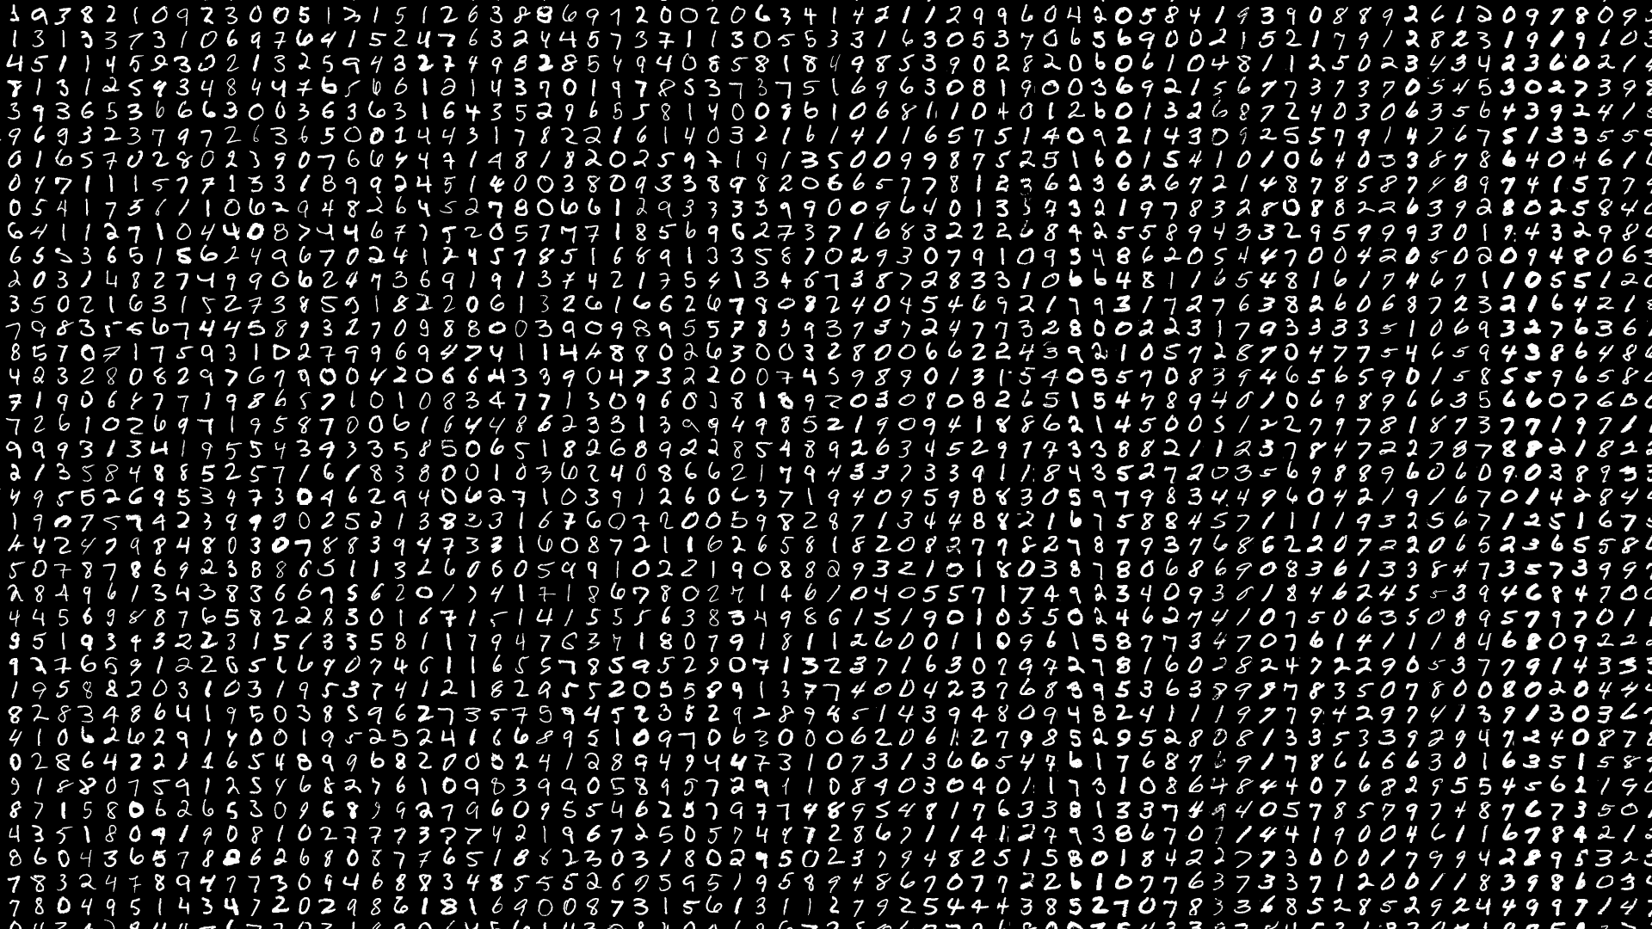

FruitPunch AI Code
Epoch 2: MNIST Challenge
18.06.2019
M. Alican Noyan

Slide 2
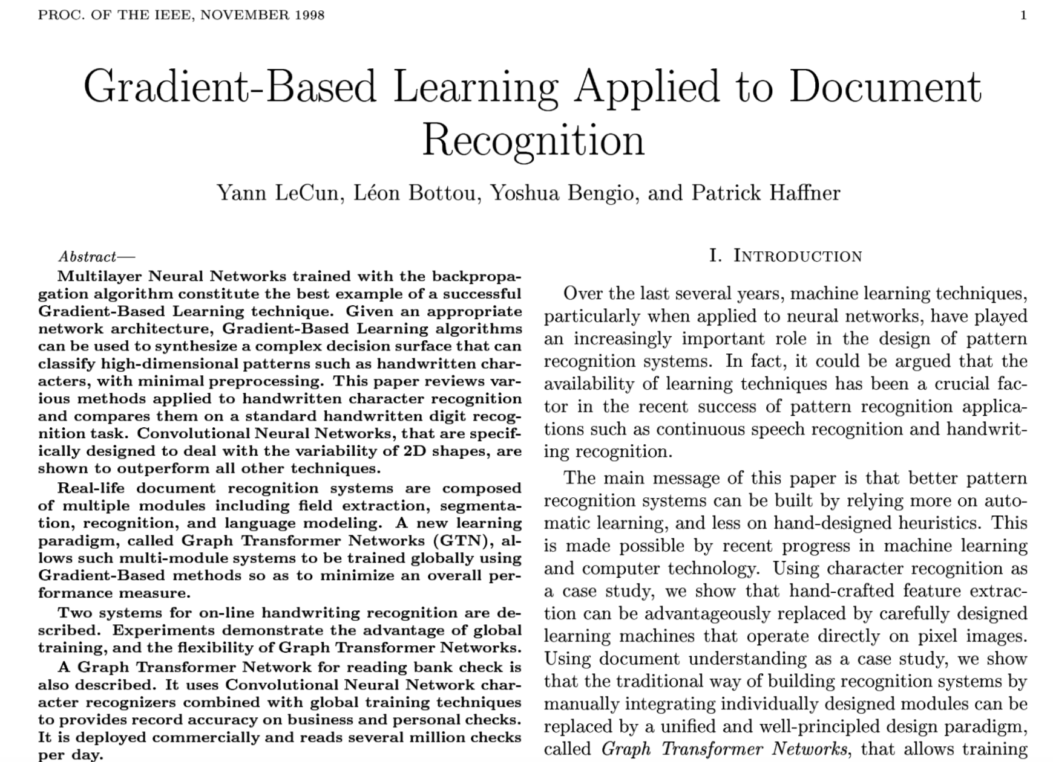
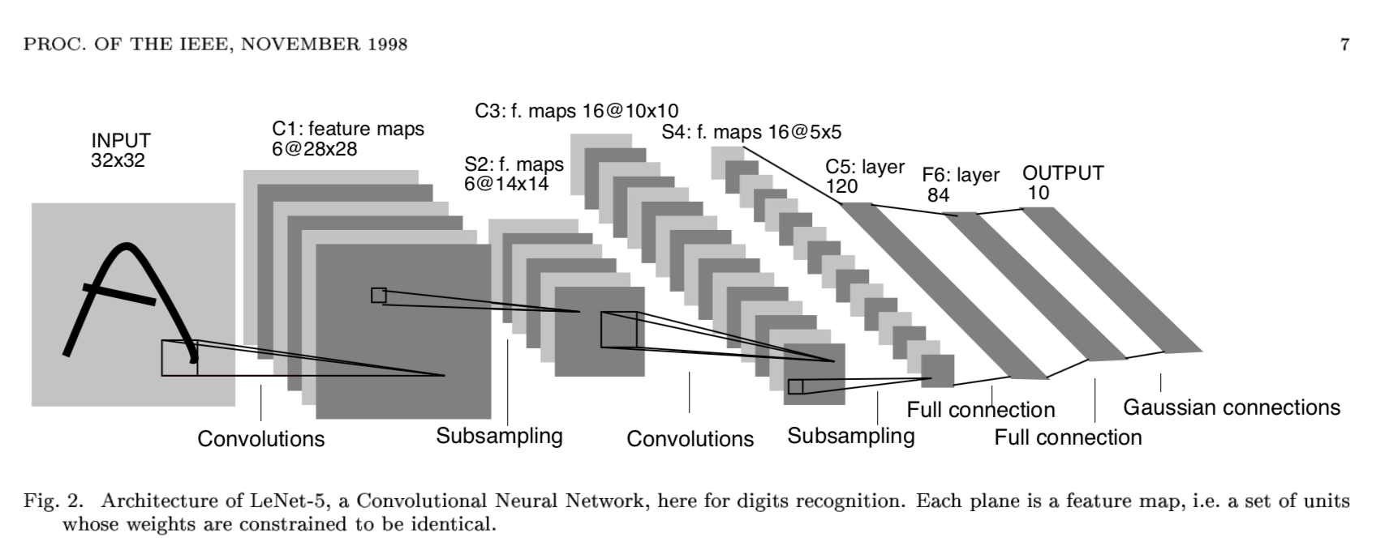
Background
> 99 % SOTA > 99.5 %

Slide 3
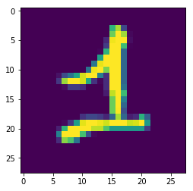

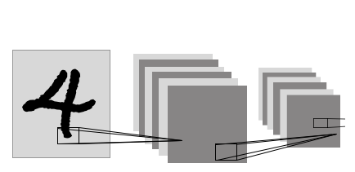
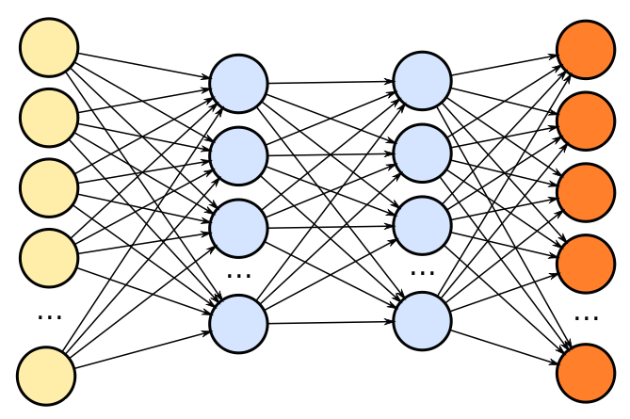
Given an image of a hand-written digit, build a function that outputs the digit.
1
Challenge 1
Challenge 2
Challenge 3
Challenge 4
Use ML
Don’t use NN
Hard code
Use a FC NN
Use a CNN
Binary classifier
“1” or not

